Slide 1
Geography A Level Introduction
Mrs BP (Subject Lead)

Slide 2
Paper 1 30% | Paper 2 30%
A: Tectonic processes and hazards Dynamic landscapes 16/105 15% of paper | A: Superpowers Dynamic places 16/105 15% of paper A: Globalisation Dynamic places 16/105 15% of paper
B: Coastal landscapes Landscape systems processes and change 40/105 38% of paper | B: Diverse places Shaping Places 35/105 33% of paper
C: Water cycle and insecurity Physical systems and sustainability C: Energy and Carbon cycles Physical systems and sustainability 49/105 46% of paper (23% each) | C: Development Health, human rights and Intervention Global development and connections 38/105 36% of paper
The largest % of the marks come from papers 1 and 2.
Worth 60% of your A level.

Slide 3
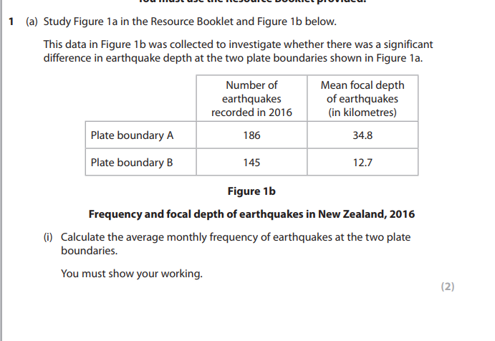
Physical paper Questions
(b) Assess the reasons why some communities are more vulnerable than others to tectonic hazards. (12) (1.5 pages)
Explain the physical processes that affect the rate of coastal recession. (6)
(d) Evaluate the view that hard engineering approaches to coastal management produce more winners than losers. (20) 2.5 pages
Explain why the price of water varies globally. (8)

Slide 4
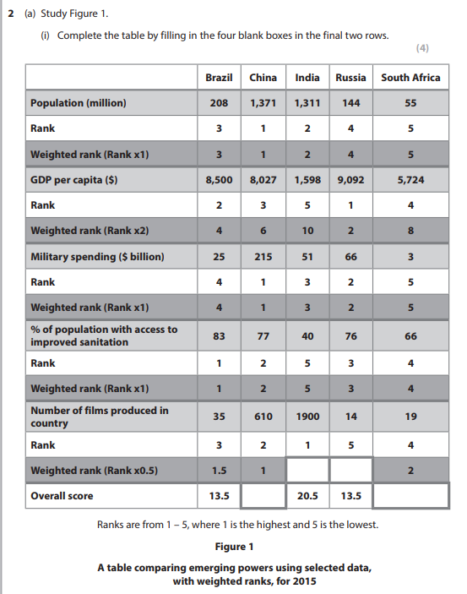
Human Questions
(a) Explain one reason why the global shift of industry has had negative impacts on some people in the developed world. (4)
Assess the view that Figure 1 gives an accurate summary of the relative strength of these emerging powers. (12)
(ii) Suggest reasons why perceptions of living in an inner-city area, such as in London, may vary. (6)
Evaluate the view that economic development always has negative consequences for minority groups. (20)

Slide 5
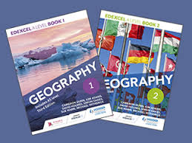
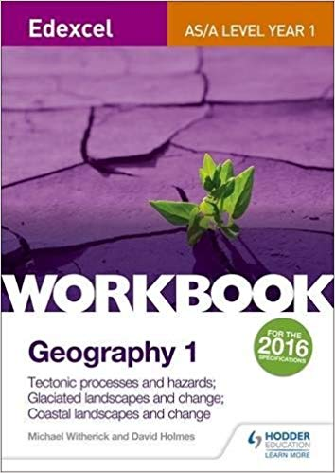
Edexcel A level book 1 - GEOGRAPHY
Hodder
Also do revision guide and workbooks.

Slide 6
Unit 3 - Synoptic Paper 20%
Issues booklet in the exam
8 pages long
Read then answer questions
Use knowledge from booklet and whole course of study.
Superpowers globalisation tectonics focussed

Slide 7
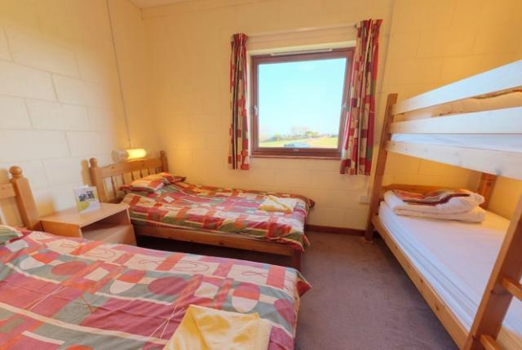
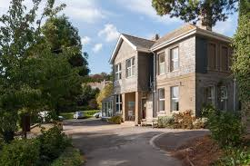
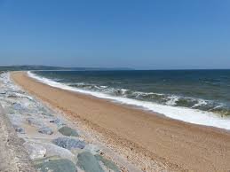
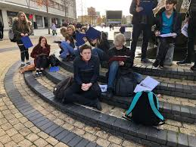
Unit 4
Coursework 20%
Trip March 2020
Letter home in October
3-4 days
Cost around £300
5,000+ word coursework
Independent investigation

Slide 8
Year 12 sneak peek
TEACHER | Term 1 | Term 2 | Term 3 | FIELD TRIP MARCH SLAPTON LEY | Term 4 | Term 5 | Term 6
A (4 lessons per fortnight) | Coastal Environments EQ1 and 2 | Coastal Environmental EQ3 and 4 | Tectonics EQ1 |  | Tectonics EQ2 /3 ¼ lessons Fieldwork | Superpowers EQ3 ¼ lessons Fieldwork
B (4 lessons per fortnight) | Diverse Places EQ1 and 2 | Diverse Places EQ3 and 4 | Globalisation EQ1 |  | Globalisation EQ2 /3 ¼ lessons Fieldwork | Superpowers EQ1 and 2 ¼ lessons Fieldwork

Slide 9
Time to speak to our current year 12 students
Coursework?
Trip?
Lessons ?

Slide 10
SUPERPOWER GEOGRAPHIES
What does ‘Superpower’ mean in this context?
Post-it time

Slide 11
What is a superpower?
A superpower is a state with a dominant position characterised by its extensive ability to exert influence or project power on a global scale.
This is done through the combined-means of economic, military, technological and cultural strength

Slide 12
So Who is the biggest superpower? And Why?
What sort of factors will we need to look at to make a judgement?
THINK-PAIR- SHARE
Germany
Saudi
Arabia
China
Brazil
India
Russia
USA
UK
South Africa
Japan

Slide 13
Factors
Country | Military spending 2019 US$ billion | Population | GDP per capita IMF 2019 | ODA in billion
USA | 643 1 | 330m 3 | 62,606 1 | $31.08 billion 2
China | 168 2 | 1.4b 1 | 9,608 7 | $38 billion 1
Saudi | 82.9 3 | 34,268,528 10 | 23,566 5 | 3 billion 6
Russia | 63 4 | 145,872,256 5 | 11,327 6 | $1.14 billion 8
India | 57 5 | 1.3b 2 | 2,036 | $1.60 billion 7
UK | 56 6 | 67,530,172 8 | 42,558 3 | $18.70 billion 3
Japan | 47 7 | 126,860,301 6 | 39,306 4 | $10.4 billion ⁵
Germany | 45 8 | 83,517,045 6 | 48,264 2 | $17.78 billion 4
BraZIL | 28 9 | 211,049,527 4 | 8,968 8 | n/a
South Africa | 3.6 10 | 58,558,270 9 | 2000 | N.a
How does this help us to judge if a country is a global power?
How important is this factor?
Any limitations?
Why could population be a superpower factor?
How important is this factor?
Limitations?
Why can we look at economics to judge power?
How important is this factor?
most/least?
weighting?
Why?
Limits?
What is this?
Why can it help us to judge?
Importance?

Slide 14
Analysis
Who was in the top 3 every time?
Who is the biggest superpower according to these factors?

Slide 15
USA -
Hyper power !

Slide 17
What will i need for September?
A small file for each geography topic - you will need to bring this with you EVERY LESSON so we recommend one per topic
Recycled lined paper
Join our google classroom to find course information and summer transition work iwakiq

Slide 18
Summer Transition Work
1 - PREPARE FOR PHYSICAL GEOGRAPHY BY .....Going over your Coasts Topic From GCSE create. You can use GCSE bite size or your old revision guide or text book to do this. Make summary notes / a poster on your revision. Make key word definition lists to help you access the A Level language in September. Key areas include Processes, Landforms, Risks and Management.
2- PREPARE FOR HUMAN GEOGRAPHY BY.........Reading the attached article on PLACE. Using your understanding of the article, and some of the key concepts you have researched, create an spider diagram, thinking map or poster about ‘The place I call home’.
READING - Geography: A Very Short Introduction (Very Short Introductions) Paperback – 22 May 2008 by John A. Matthews (Author), David T. Herbert (Author) (£5 on Amazon)
Have a read through the coasts / Diverse Places topics in our text books (in classroom)
It would be great if you could show you teachers evidence of this work on your first lesson of year 12.

Slide 19
USA

Slide 20
China

Slide 21
Germany

Slide 22
UK

Slide 23
South Africa

Slide 24
Japan

Slide 25
Saudi Arabia

Slide 26
Russia

Slide 27
Brazil

Slide 28
India

